Slide 1
Girish Wagh
Managing Director and CEO Tata Motors Limited

Slide 2

Safe harbour statement
Statements in this presentation describing the objectives, projections, estimates and expectations of Tata Motors Limited may be “forward- looking statements” within the meaning of applicable securities laws and regulations. Actual results could differ materially from those expressed or implied. Important factors that could make a difference to the Company’s operations include, amongst others, economic conditions affecting demand / supply and price conditions in the domestic and overseas markets in which the Group operates, changes in Government regulations, tax laws and other statutes and incidental factors.
Certain analysis undertaken and represented in this document may constitute an estimate from the Company and may differ from the actual underlying results.
Presentation format : The financial data provided represent details on Standalone level including Joint operations with Tata Cummins.
Reported EBITDA is defined to include the product development expenses charged to P&L and realised FX and commodity hedges but excludes the gain/loss on realized derivatives entered into for the purpose of hedging debt, revaluation of foreign currency debt, revaluation of foreign currency other assets and liabilities, MTM on FX and commodity hedges, MTM on unquoted investments, other income (except government grant) as well as exceptional items.
Reported EBIT is defined as reported EBITDA plus profits from equity accounted investees less depreciation and amortisation.
Free Cash Flow is is defined as net cash generated from operating activities less net cash used in automotive investing activities, including realised profit/ loss on sale of mutual funds and excluding investments in consolidated entities, M&A linked asset purchases and movements in financial investments, and after net finance expenses (including interest on leases) and fees paid.
Reported ROCE (Auto) is analytically derived by dividing the EBIT for the last 12 months by the average of the capital employed (YoY).
Non-cyclical business includes International business, Smart city mobility , non vehicular business, digital business and defence business.

Slide 3
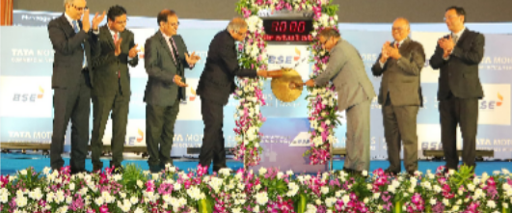
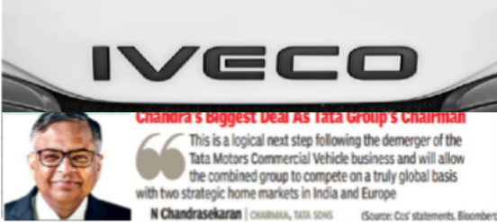
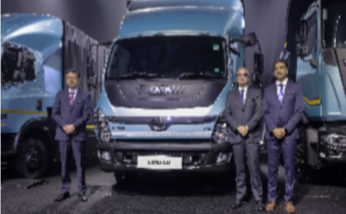
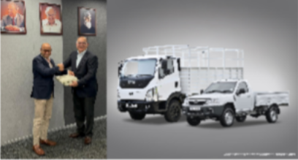


The Year Gone By
BSE Listing Ceremony
Bold strategic step to acquire Iveco; approvals under process
Future-Ready Mobility Unveiled: 14 vehicles, 4 aggregates, 6 smart solutons
Secured biggest order for 70,000 Yodha and Ultra T.7 Vehicles for deployment in Indonesia
Fleetedge at scale: 1M+ Connected Vehicles Driving Uptime
Launch of “Better Always” Positioning

Slide 4

Journey of consistent delivery
Revenues ₹ KCr. Consistent increase in scale ₆₆ ₇₃ ₆₉ 77 FY23 FY24 FY25 FY26 | EBITDA ₹ KCr. and % EBITDA KCr Sharp improvement in margins _{EBITDA %} ^{12.0} 16.0% 12.0% ^{13.2%} 14.0% 10.0 11.0% _{10.2} 12.0% 8.0 ^{7.8%} 8.1 8.4 ^{10.0%} 8.0% 6.0% 4.0 _{5.1} 4.0% 2.0 2.0% ⁻ 0.0% FY23 FY24 FY25 FY26 | PBT (bei) ₹ KCr. and EBIT % _{PBT (bei)} Robust PBT (bei) in FY26 EBIT% turns double digit in FY26 ^{EBIT %} 15.0 16.0% 13.0 14.0% 11.0 11.0% 12.0% 9.0 _{8.3%} 9.2% 10.0% 7.0 _{8.7} 8.0% 5.0 5.1% 6.0% _{5.0} 6.0 3.0 4.0% 1.0 2.0% 1.5 (1.0) 0.0% FY23 FY24 FY25 FY26
Non Cyclical Revenue Growth _{Non Cyclical} Non-cyclical CAGR 2.7x cyclical _{Growth} business CAGR 18% 11% _{13%} 11% 9% FY24 ^{-7%} FY26 FY25 | FCF & Investments Spends ₹ KCr _{FCF} FCF generation ~ 12% 9.2 7.0 6.0 3.1 _{2.3} 3.0 2.9 2.8 FY23 FY24 FY25 FY26 | Auto ROCE % Industry Leading ROCE's 72 61 ₈ 14 FY23 FY24 FY25 FY26
FY25 numbers are restated taking account for demerger related entries
Auto ROCE (Return on Capital Employed): EBIT/Average Capital Employed
For analytical purposes only
Annual General Meeting 2026
4

Slide 5
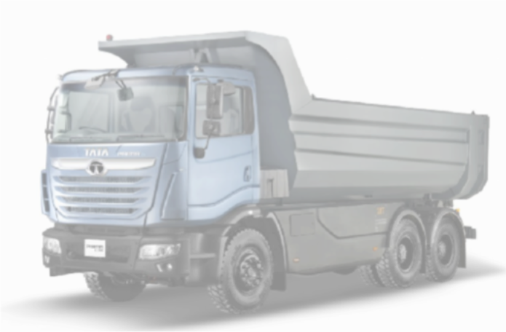
FY26 improves further over FY25
S t a n d a l o n e i n c l u d i n g J o i n t O p e r a t i o n s T a t a C u m m i n s |IndAS, ₹K Cr
 | FY26 | FY25 | Y-O-Y
Wholesales ( K units) | 428.1 | 376.8 | 14%
Revenue | 77.4 | 69.4 | 11%
EBITDA (%) | 13.2% | 12.0% | 120 bps
EBIT(%) | 11.0% | 9.2% | 180 bps
PBT (bei) | 8.7 | 6.0 | 2.7
Free Cash Flow | 9.2 | 7.0 | 2.2
Net Cash/(Debt) | 7.5 | 1.6 | 5.9
Auto ROCE (%) | 72.3 | 61.3 | 1100 bps

Slide 6





Performance has been acknowledged by rating agencies
Commentary highlights from rating agencies
Leadership position in India CV market
  Strong product portfolio, extensive distribution network and cost leadership
  Strong position despite increasing competitive intensity.
Strong financial profile
  Healthy margins, low leverage, robust liquidity
  Healthy profitability and strong free cash flow driving deleveraging
Enjoys exceptional financial flexibility for being a part of the Tata Group along with financial support from Tata Sons
R a t i n g _{P r e - D e m e r g e r} C u r r e n t A g e n c i e s R a t i n g s

Slide 7
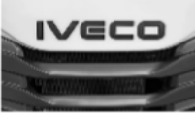



Corporate actions in the past year are strategic, aimed at further strengthening our position
Key Actions
Status
Strategic Rationale
Expand TMCV's footprint into global markets
Most of the approvals in place
Transaction on course for completion by Q2 FY27
IVECO
Acquisition
Unlock technology synergies across powertrains, procurement leverage through shared platforms
AIEQU Mobility to be the holding entity for Fleetedge & Freight Tiger
Freight Tiger has become a subsidiary of TMCV starting Q1 FY27
Forms an integrated tech-led logistics ecosystem play
DIGITAL STRATEGY
Gamut of digital business housed in one single entity
With Fleetedge & Freight Tiger, AIEQU Mobilty will cover both truck & trip ecosystem, with end-to-end solutions across the logistics value chain

Slide 8






CV industry being reshaped globally, domestic demand remains strong
Global CV industry going through a paradigm shift
4 Global Megatrends
Continued domestic demand growth, despite rising fuel prices
Macro & infrastructure
Consumption & shared mobility
Input costs
Stable regulatory roadmap Established scrappage policy Electrification push
Headwinds are cyclical and manageable; Tailwinds are
Connected
Strong Demand Drivers
ADAS
Decarbonization
Stable Regulatory Outlook
Software-centred vehicle design
Your company is investing in key megatrends to drive
lifecycle value and sustainable mobility leadership
structural and durable
8

Slide 9





Three pillars to drive next phase of value creation
Vision
Trusted, globally recognized mobility solutions leader with sustainability at the core
STRENGTHEN THE CORE
SCALE NEW GROWTH ENGINES
STRATEGIC GLOBAL PIVOT
Strategic
Pillars
Defend & grow domestic leadership
Enabling customer success
Leading India’s CV electrification
Grow Downstream & Digital
International business
expansion
IVECO acquisition
Technology & AI Focus
Key Enablers
Sustainability Leadership
9

Slide 10
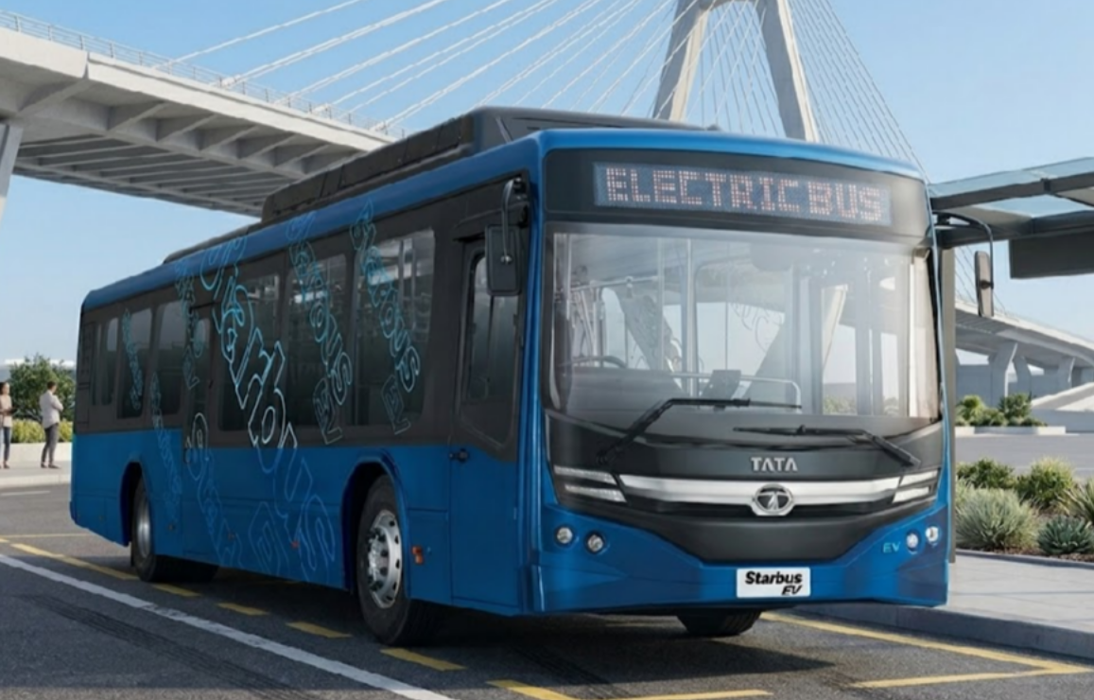
Thank You

